Slide 1



Slide 2
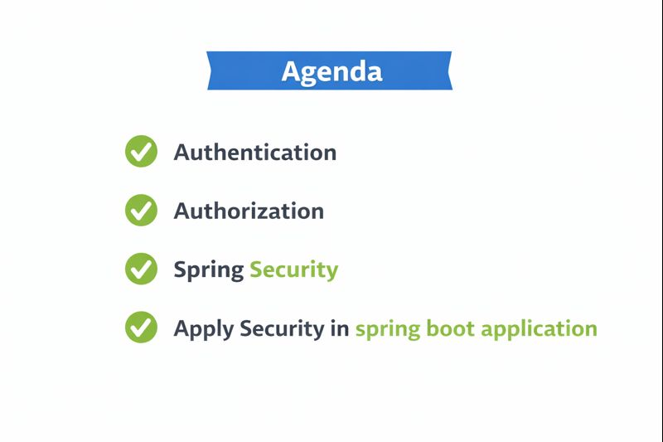

Slide 3
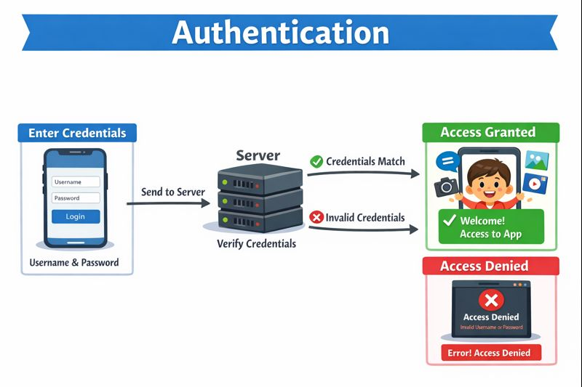
Authentication is the process of verifying who you are. In a Spring Boot application, this involves checking your credentials (like a username and password) against the stored data, and if they match, you're granted access to the system, much like being allowed into a mall after showing a valid ID.

Slide 4
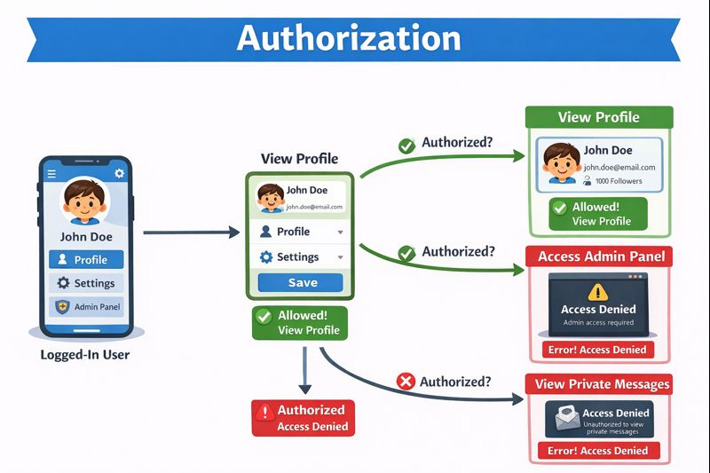
Authorization is the process of determining what you can and cannot do within the app after you've logged in. Even though you're authenticated and allowed into the app, your permissions decide whether you can access certain features or areas, like editing your settings or accessing the admin panel.

Slide 5


Slide 6
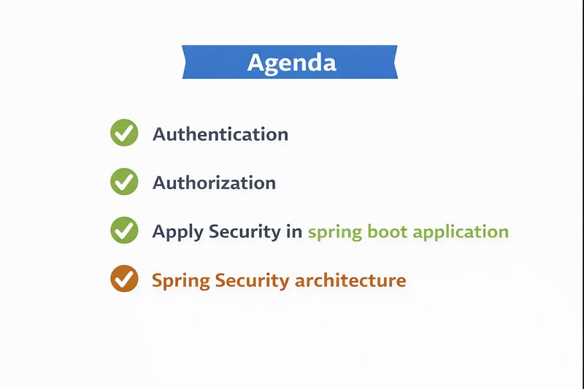

Slide 7


